Slide 1
GMPLS

Slide 2
GMPLS
ASON
  Automatic switched optical network (ASON)
    Framework for control plane of optical networks
    Facilitates set-up, modification, reconfiguration, and release of
      Switched connections
        Controlled by clients (e.g., IP, ATM, SONET/SDH)
      Soft-permanent connections
        Controlled by network management system
    Consists of one or more domains belonging to different network operators, administrators, or vendor platforms
    Points of interaction between different domains are called reference points
      User-network interface (UNI)
      External network-network interface (E-NNI)
      Internal network-network interface (I-NNI)

Slide 3
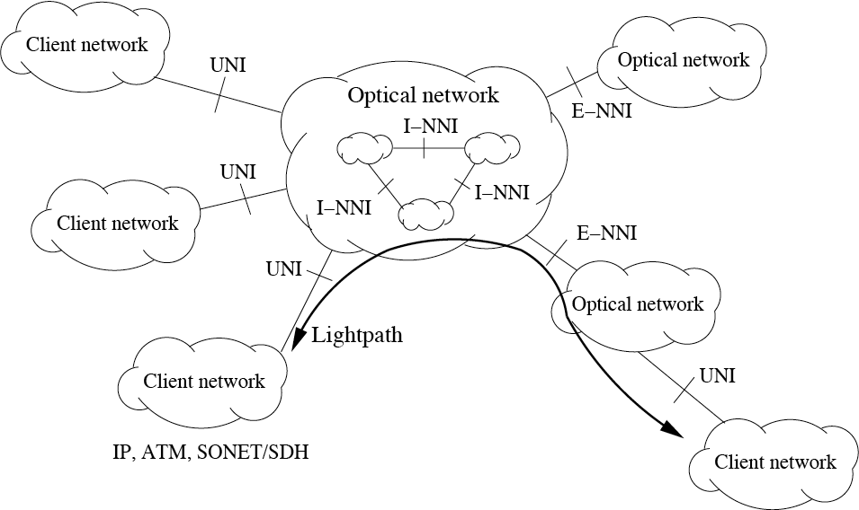
GMPLS
ASON reference points

Slide 4
GMPLS
MPLS
  ASON framework does not specify any control protocol
  In an ASON, OADMs & OXCs may be optically bypassed & thereby prevented from accessing corresponding wavelength channels
  As a consequence, in-band signaling ruled out in favor of out-of-band control techniques for optical switching networks
  Multiprotocol label switching (MPLS) provides promising foundation for optical control plane since MPLS decouples control & data planes
    Reuses & extends existing IP routing & signaling protocols
    Introduces connection-oriented model in connectionless IP context
    Requires encapsulation of IP packets into labeled packets

Slide 5
GMPLS
Labeled packets
  Realization of label depends on link technology in use
    For instance, in ATM networks virtual channel identifier (VCI) & virtual path identifier (VPI) may be used as labels
    Alternatively, MPLS shim header may be added to IP packet & used as label
  Labeled packets are forwarded along label switched paths (LSPs)

Slide 6
GMPLS
LSP
  LSPs are similar to virtual circuits & virtual paths in ATM networks
  MPLS routers are called label switched routers (LSRs) & are categorized into
    Label edge routers (LERs)
      Located at edge of MPLS domain
      Able to set up, modify, reroute, and tear down LSPs by using IP signaling & routing protocols with appropriate extensions
    Intermediate LSRs
      Do not examine IP header during forwarding
      Instead, they forward labeled IP packets according to label swapping paradigm
        Each LSR maps particular input label & port of arriving labeled IP packet to output label & port
        Mapping information provided during LSP set-up

Slide 7
GMPLS
MPLS benefits
  Enables converged multiservice networks & eliminates redundant network layers by incorporating some ATM & SONET/SDH functions to IP/MPLS control plane
    Supports reservation of network resources
    Allows explicit & constraint-based routing for traffic engineering (TE) & fast reroute (FRR)
      => IP/MPLS can replace ATM for TE & SONET/SDH for protection/restoration
    Provides possibility of stacking labels
      => Labeled IP packets can have one, two, or more labels <=> only two labels in ATM networks (VCI/VPI)
      => Allows to build arbitrary LSP hierarchies

Slide 8
GMPLS
MPLS shortcomings
  Unable to establish bidirectional LSP in single request
    Set-up of bidirectional LSP done by establishing two separate counterdirectional LSPs independently
    => Increased control overhead & set-up delay
  Protection bandwidth cannot be used by lower-priority traffic during failure-free network operation
    Lower priority traffic cannot be pre-empted in event of network failure in favor of higher-priority traffic
    => Protection bandwidth goes unused during failure-free operation

Slide 9
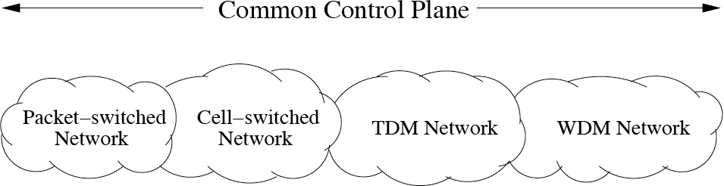
GMPLS
GMPLS
  MPLS designed to support only packet-switching devices
  To be used as common control plane for disparate types of optical switching networks, MPLS must be extended => Generalized MPLS (GMPLS)
    Supports not only packet/cell-switched but also TDM, WDM, and fiber (port) switched optical networks
  GMPLS adds required intelligence to control plane of optical networks => intelligent optical networks (IONs)

Slide 10
GMPLS
Generalized label
  To deal with widening scope into time & optical domains, several new forms of label are required, collectively referred to as generalized label
  Generalized label
    Contains information to allow GMPLS node to program its cross-connect, regardless of cross-connect type
    Extends traditional in-band labels (e.g., VCI, VPI, shim header) by allowing labels which are identical to time slots, wavelengths, or fibers (ports)
    GMPLS nodes know from context what type of label to expect

Slide 11
GMPLS
Interface switching capability
  GMPLS operates over wide range of heterogeneous LSRs (e.g., IP/MPLS routers, SONET/SDH network elements, ATM switches, OXCs, and OADMs)
  Different types of GMPLS LSRs can be categorized according to their interface switching capability (ISC)

Slide 12
GMPLS
ISC
  Interfaces of a GMPLS LSR can be subdivided into
    Packet switch capable (PSC) interfaces
      Recognize packet boundaries & forward data based on content of packet header (e.g., MPLS shim header)
    Layer-2 switch capable (L2SC) interfaces
      Recognize frame/cell boundaries & switch data based on content of frame/cell header (e.g., ATM VPI/VCI)
    Time-division multiplex capable (TDM) interfaces
      Switch data based on data’s time slot in repeating cycle (e.g., SONET/SDH DCS & ADM)
    Lambda switch capable (LSC) interfaces
      Switch data based on wavelength/waveband on which data is received (e.g., WSXC/waveband switching [WBS])
    Fiber switch capable (FSC) interfaces
      Switch data based on position of data in physical space (e.g., OXC)

Slide 13
GMPLS
LSP hierarchy
  Each interface of a given GMPLS LSR may support a single ISC or multiple ISCs
  In GMPLS networks, an LSP can be established only between interfaces of the same type
  LSPs established between pairs of network elements with different ISCs can be nested inside each other => hierarchy of LSPs
  LSP hierarchy
    Can be realized in conventional MPLS networks by means of label stacking & nesting LSPs inside other LSPs
    In GMPLS networks, LSP hierarchy can be built between generalized LSRs with the same ISC, whereby lower-order LSPs are nested inside higher-order LSPs

Slide 14
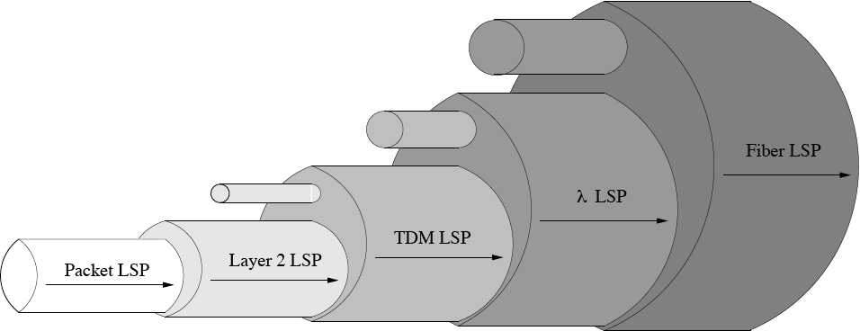
GMPLS
LSP hierarchy
  Packet LSP starting & ending on PSC interfaces may be nested inside layer 2 LSP, which in turn may be nested together with other layer 2 LSPs inside TDM LSP, …
  Each type of LSP starts & ends at LSRs whose interfaces have the same switching capability => LSP tunnels

Slide 15
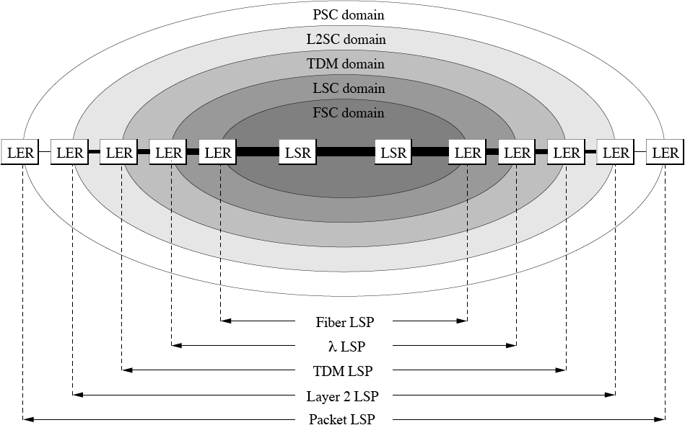
GMPLS
LSP tunnels

Slide 16
GMPLS
LSP control
  Lower-order LSPs (e.g., lambda LSPs) may be nested inside higher-order LSP (e.g., fiber LSP)
  Higher-order LSP forms tunnel for nested lower-order LSPs
  LSP tunneling subject to two constraints
    Higher-order LSP must be already established
    Higher-order LSP must have sufficient spare capacity
  If constraints are not satisfied, a new lower-order LSP will trigger set-up of higher-order LSP tunnels

Slide 17
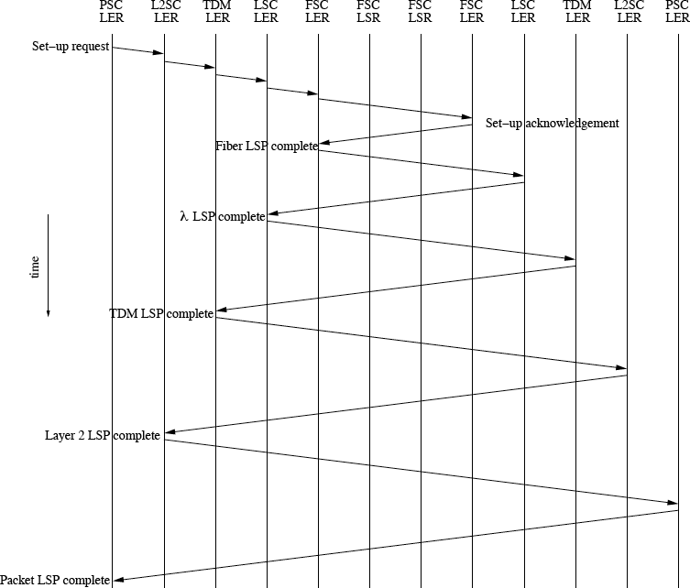
GMPLS
Set-up of LSP tunnels

Slide 18
GMPLS
TE link
  To facilitate not only legacy shortest path first (SPF) but also constraint-based SPF routing of LSPs, LSRs need more information about network links than provided by standard IGPs (e.g., OSPF & IS-IS)
  Additional link information provided by TE attributes
  TE attributes
    Describe characteristics of associated link such as ISC, unreserved bandwidth, maximum reservable bandwidth, protection/restoration type, and shared risk link group (SRLG)
      SRLG represents group of links that share the same fate in event of failures
    Link together with associated TE attributes is called TE link
    IGP used to flood link state information about TE links
  TE links connect pairs of adjacent LSRs

Slide 19
GMPLS
Forwarding adjacency
  TE links can be extended to nonadjacent LSRs by using the concept of forwarding adjacency
  Forwarding adjacency (FA)
    LSR advertises an LSP as a TE link into a single routing domain
    Such a link is called an FA & corresponding LSP is called an FA-LSP
    FAs provide virtual (logical) topology to upper layers
    FAs may be identical (i.e., interconnect same LSRs) even though corresponding FA-LSPs have different paths
    Information about FAs are flooded by IGP like that of TE links

Slide 20
GMPLS
Link bundling & unnumbered links
  To reduce amount of flooded link state information & thereby improve scalability of GMPLS networks, TE links & FAs can be bundled and/or unnumbered
    Link bundling
      Attributes of several TE links & FAs of the same link type (i.e., point-to-point or multi-access), same TE metric, and same pair of start & end LSRs are aggregated to a single bundled link
      Bundled link may consist of mix of TE links & FAs
      Only state information of bundled link is flooded by IGP
    Unnumbered links
      Links are not assigned any IP addresses
      Instead, each LSR numbers its links locally
      Tuple [LSR IP address, local link number] used to uniquely identify each link

Slide 21
GMPLS
Link management
  In GMPLS networks, data plane & control plane are decoupled
  Control channels exist independently of TE links they manage => out-of-band control channels
  Link management protocol (LMP)
    Specified to establish & maintain out-of-band control channels between neighboring nodes & to manage data TE links between them
    Designed to accomplish four tasks
      Control channel management (mandatory)
      Link property correlation (mandatory)
      Link connectivity verification (optional)
      Fault management (optional)

Slide 22
GMPLS
LMP
  Control channel management
    In LMP, one or more bidirectional control channels must be activated (their implementation being left unspecified)
    Control channel examples
      Separate wavelength or fiber, virtual circuit, Ethernet link, IP tunnel through management network, or overhead bytes of a data link protocol
    Each node assigns local control channel identifier to each control channel (identifier taken from same space as unnumbered links)
    To establish a control channel, source node on local end of control channel must know destination IP address on remote end of control channel
    In general, this knowledge may be explicitly configured or automatically discovered

Slide 23
GMPLS
LMP
  Control channel management
    Currently, LMP assumes that control channels are explicitly configured while their configuration can be dynamically negotiated
    LMP consists of two phases
      Parameter negotiation phase
        Several negotiable parameters are negotiated & non-negotiable parameters are announced
        Among others, HelloInterval & HelloDeadInterval parameters must be agreed upon prior to sending keep-alive messages
      Keep-alive phase
        Hello protocol can be used to maintain control channel connectivity & detect control channel failures
        Alternatively, lower-layer protocols can be used (e.g., SONET/SDH overhead bytes)

Slide 24
GMPLS
LMP
  Link property correlation
    Defined for TE links to ensure that both local & remote ends of a given TE link is of the same type (i.e., IPv4, IPv6, or unnumbered)
    Allows change in a link’s TE attributes (e.g., minimum/max-imum reservable bandwidth) & to form and modify link bundles (e.g., addition of component links)
    Should be done before the link is brought up
    May be done any time a link is up & not in the verification process

Slide 25
GMPLS
LMP
  Link connectivity verification
    In all-optical networks (AONs), data TE links can be verified one by one with respect to connectivity between two neighboring nodes
    Connectivity verification of transparent data TE links is done by electrically terminating them at both ends
    Verification procedure consists of sending test messages in-band over data TE links
    Link connectivity verification should be done
      When establishing a data TE link and
      Subsequently on a periodic basis

Slide 26
GMPLS
LMP
  Fault management
    Enables network to survive node & link failures
    Includes three steps
      Fault detection
        Should be handled at layer closest to failure (e.g., optical layer in AONs)
      Fault notification
        In LMP, downstream node that has detected fault informs its neighboring node about the fault by sending control message upstream
      Fault localization
        After receiving fault notification, upstream node correlates fault with corresponding interfaces to determine whether fault is between neighboring nodes
    Once failure is localized, signaling protocols may be used to initiate LSP protection & restoration procedures

Slide 27
GMPLS
Routing
  To facilitate set-up of LSPs, TE routing extensions to widely used link state routing protocols OSPF & IS-IS in support of carrying TE link state information were defined
  TE routing extensions
    Allow not only conventional topology discovery but also resource discovery via link state advertisements (LSAs) of OSPF/IS-IS
    Each LSR disseminates in its LSAs resource information of its local TE links & FAs across control channel(s) provided by LMP
    In addition, LSRs may advertise optical resource information (e.g., wavelength value, physical layer impairments such as PMD, ASE, nonlinear effects, crosstalk)
    LSAs enable all LSRs in routing domain to dynamically acquire & update coherent picture of network called link state database
    Link state database consists of all LSRs, all conventional links, TE attributes of all links, and all FAs in a given routing domain
    Link state database used to perform path computation

Slide 28
GMPLS
Path computation
  Path computation is typically proprietary => allows manufacturers & vendors to pursue diverse strategies and differentiate their products
  Issues & challenges
    Lightpath routing & wavelength assignment (RWA)
      Routing algorithms
        Fixed
        Fixed-alternate
        Adaptive (dynamic)
      Wavelength assignments heuristics
        First-fit
        Least-loaded …
      Wavelength continuity constraint => wavelength path

Slide 29
GMPLS
Path computation
  Issues & challenges
    Apart from lightpaths, paths need to be computed for GMPLS networks of any ISC
    Constrained shortest path first (CSPF) routing
      Link state database used to construct weighted graph that satisfies requirements of a given connection set-up (e.g., TE links with insufficient unreserved bandwidth can be pruned from link state database)
      Paths computed by running SPF routing algorithm over weighted graph
    Service differentiation
      Path computation needs to support different classes of service (CoS) & fulfill QoS requirements of each class
      Hybrid offline-online routing procedures may be used to compute paths for high-priority LSPs (offline) & low-priority LSPs (online)

Slide 30
GMPLS
Signaling
  After path computation, signaling is used to establish LSP
  For signaling in GMPLS networks, TE extensions were defined for widely used signaling protocols Resource Reservation Protocol (RSVP-TE) & Constraint-Based Routing Label Distribution Protocol (CR-LDP)
  RSVP-TE & CR-LDP enable LSPs to be
    Set up
    Modified
    Released
  Advantageous features of GMPLS signaling
    Upstream LSR can suggest label that may be overwritten by downstream LSR (e.g., wavelength assignment by source LSR)
    In RSVP-TE, Notify message was defined to inform any LSR other than immediate upstream or downstream LSR of LSP-related failures => decreased failure notification delay & improved failure recovery time

Slide 31
GMPLS
Crankback
  In ASON, GMPLS signaling should support crankback
  Crankback
    Allows LSP set-up to be retried on alternate path that detours around link or node with insufficient resources
    Steps of crankback signaling
      Blocking resource (link or node) is identified & returned in an error message to upstream repair node
      Repair node computes alternate path around blocking resource that satisfies LSP constraints
      After path computation, repair node reinitiates LSP set-up request
    Limited number of retries at a particular repair node
    When number of retries has been exceeded, current repair node reports error message upstream to next repair node for further rerouting attempts
    When maximum number of retries for specific LSP is reached, current repair node should send error message to ingress node

Slide 32
GMPLS
Bidirectional LSP
  In traditional MPLS networks, two pairs of initiator & terminator LSRs required to set up two unidirectional LSPs
    Set-up latency equal to one round-trip signaling time plus initiator-terminator transit delay
    Control overhead twice that of unidirectional LSP
    Complicated route selection for the two directions
    Difficult to provide clean interface to SONET/SDH equipment
  Non-PSC applications (e.g., bidirectional lightpaths) motivate need for bidirectional LSPs
    Only one pair of initiator & terminator LSRs requiring a single set of signaling messages => reduced control overhead & set-up latency similar to unidirectional LSP
    Set-up signaling message carries one downstream label & one upstream label
    Contention of labels may be resolved by imposing policy at each initiator (e.g., initiator with higher ID wins contention)

Slide 33
GMPLS
Fault recovery
  Fault recovery typically takes place in four steps
    Fault detection
      Recommended to be done at layer closest to failure => physical layer in optical networks
      Fault can be detected by detecting loss of light (LOL) or measuring OSNR, dispersion, crosstalk, or attenuation
    Fault localization
      Achieved through communication between nodes to determine where failure has occurred
      Fault management procedure of LMP can be used
    Fault notification
      Achieved by sending RSVP-TE or CR-LDP error messages to source LSR or intermediate LSR
    Fault mitigation
      Achieved by means of protection and restoration

Slide 34
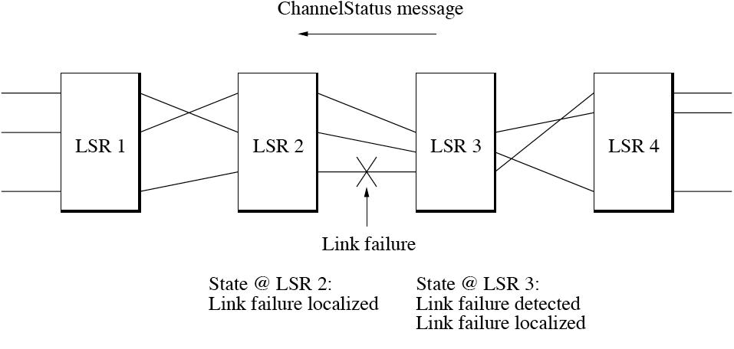
GMPLS
Fault localization
  In LMP fault management procedure, ChannelStatus message can be sent unsolicited to neighboring LSR to indicate current link status: SignalOkay, SignalDegrade, or SignalFail

Slide 35
GMPLS
Fault mitigation
  Fault mitigation techniques can be categorized into
    Protection
      Resources between protection end points established before failure
      Connectivity after failure achieved by switching at protection end points
      Proactive technique
      Aims at achieving fast recovery time at expense of redundancy
    Restoration
      Uses path computation & signaling after failure to dynamically allocate resources along recovery path
      Reactive technique
      Takes more time than protection but provides more bandwidth-efficient fault mitigation

Slide 36
GMPLS
Protection & restoration
  Both protection & restoration can be applied at various levels throughout the network
    Link (span) level
      Used to protect a pair of neighboring LSRs against single link or channel failure => line switching
    Segment level
      Used to protect a connection segment against one or more link or node failures => segment switching
    Path level
      Used to protect entire path between source & destination LSRs against one or more link or node failures => path switching

Slide 37
GMPLS
Protection schemes
  Several protection schemes exist for line, segment, and path switching
    1+1 protection (dedicated)
      Two link-, node-, and SRLG-disjoint resources (link, segment, path) used to transmit data simultaneously
      Receiving LSR uses selector to choose best signal
    1:1 protection (dedicated)
      One working resource & one protecting resource are pre-provisioned, but data is sent only on former one
      If working resource fails, data is switched to latter one
    1:N protection (shared)
      Similar to 1:1 protection, but protecting resource is shared by N working resources
    M:N protection (shared)
      M protecting resources are shared by N working resources, where 1 ≤ M ≤ N

Slide 38
GMPLS
Restoration schemes
  Similarly, several restoration schemes exist for line, segment, and path switching
    Restoration with reprovisioning
      Restoration path dynamically calculated after failure or precalculated before failure without reserving bandwidth
    Restoration with presignaled recovery bandwidth reservation and no label preselection
      Restoration path precalculated & reserved before failure
      Upon failure detection, signaling done to select labels
    Restoration with presignaled recovery bandwidth reservation and label preselection
      Restoration path precalculated & reserved before failure
      Labels selected along restoration path before failure

Slide 39
GMPLS
Escalation strategies
  Escalation strategies used to efficiently coordinate fault recovery across multiple GMPLS layers
    Bottom-up escalation strategy
      Assumes that lower-level recovery schemes are more expedient
      Recovery starts at lowest layers (fibers, wavebands) & then escalates upward to higher layers (wavelengths, time slots, frames, packets) for all affected traffic that cannot be restored at lower layers
      Realized by using hold-off timer set to increasingly higher value
    Top-down escalation strategy
      Attempts recovery at higher GMPLS layers before invoking lower-level recovery techniques
      Permits per-CoS or per-LSP rerouting by differentiating between high-priority & low-priority traffic

Slide 40
GMPLS
Implementation
  Several experimental studies on GMPLS-based control plane were successfully carried out
    MPλS network
      IP/MPLS routers interconnected by mesh of wavelength-switching OXCs with LSC interfaces
      Multiprotocol lambda switching (MPλS)
      Control plane
        Dedicated out-of-band wavelength between two neighboring OXCs preconfigured for IP connectivity
        Transmission control protocol (TCP) used for reliable transfer of control messages

Slide 41
GMPLS
Implementation
  Several experimental studies on GMPLS-based control plane were successfully carried out
    Hikari router
      MPλS LSR that also supports IP packet switching
      Equipped with both LSC interfaces & PSC interfaces
      Offers 3R regeneration of optical signal & wavelength conversion
      Path computation selects path with least number of wavelength converters
      Based on IP traffic measurements, optical bypass lightpaths are dynamically set up & reconfigured => cost reduction of more than 50%
      Grooming used to merge several IP traffic flows to better utilize bypass lightpaths

Slide 42
GMPLS
Application
  GMPLS has great potential to reduce network costs significantly
    OPEX can be reduced on the order of 50%
  GMPLS well suited for Grid computing
    GMPLS-based connection-oriented high-capacity optical networks better suited to deliver rate- and delay-guaranteed services than connectionless best-effort Internet
    GMPLS able to meet adaptability, scalability, and heterogeneity goals of a Grid

